Slide 1



Team ID: 2AEFH5
#TechInPink2020
#TimeToEndBreastCancer
#ELCHackForPink
#ELCHackathon’20
Team: Infy Ninja
Viral Thakkar
Saurabh K Sinha

Slide 2
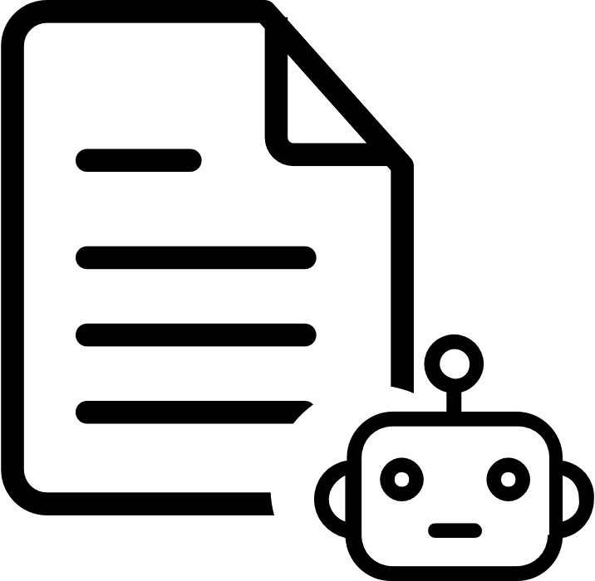

Problem
Breast cancer is the most common cancer in women worldwide.
Every 15 seconds, somewhere in the world, a woman is diagnosed with breast cancer.
Lack of early detection is the main problem. Most cases are diagnosed in late stages.
Every 15 seconds, somewhere in the world, a woman is diagnosed with breast cancer.
Lack of adequate diagnosis and treatment facilities.
The incidence of breast cancer is increasing in the developing world.
Due to increase life expectancy, increase urbanization and adoption of western lifestyles.
Almost 50% of breast cancer cases and 58% of deaths occur in less developed countries.
Over 508,000 women died in 2011 due to breast cancer.
15% of all cancer deaths among women are caused by breast cancer.
WHO
WHO
WHO
Approx. 2.1 Million women are impacted by breast cancer each year globally.
In the year 2018, nearly 2 million new breast cancer cases were diagnosed.
WHO
BCRF
Notes:
Line 1: US Bank | Merck | PWC
Line 2: Travelers | Adtalem | AmEx
Line 3: Digital Twin | NurseBot | Infosys RTW <https://www.youtube.com/watch?v=QWXOnPTkw4s&feature=emb_logo
Line 4: Digital Twin demo | KAO

Slide 3
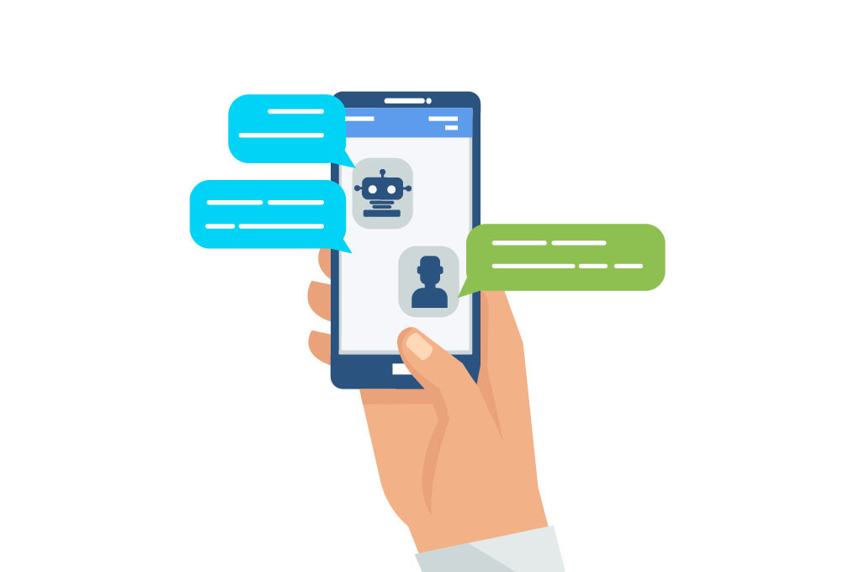


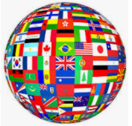



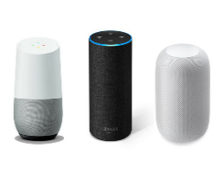

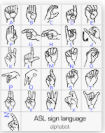
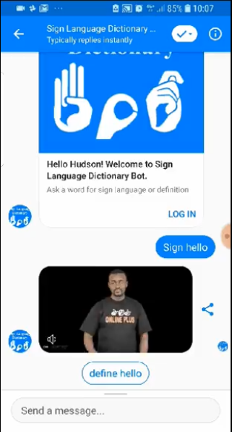

Our Solution
Solution powered through Intelligent AI
Awareness
QnA
Predictions
Connects to nearby Medical Facilities
Gamification Points and Awards
Inclusive Design
Omni-channel
Find the Nearest
Medical Facility
Access Anytime
Anywhere
Multi-Language
Available on Chatbot
Uniqueness
Get Awareness
Bot based Ads
To connect Hospitals
Powered by Richness
of Data
Available on Voicebots
Personalized Predictions
User Engagement
through Gamifications
Accessibility through all degrees of Human, even Specially-abled
Smart IVR
Notes:
Line 1: US Bank | Merck | PWC
Line 2: Travelers | Adtalem | AmEx
Line 3: Digital Twin | NurseBot | Infosys RTW <https://www.youtube.com/watch?v=QWXOnPTkw4s&feature=emb_logo
Line 4: Digital Twin demo | KAO

Slide 4
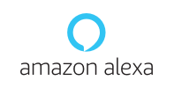






Business case - Elevate the solution pitch through Next Gen elements
Signing up medical facilities
Connecting and Sharing relevant information based on consent
Usage reporting
Behavior analytics
Sentiment insights
Failure analytics
Language processing reports
Personalization
Multi- channel
NLU Agents
Interface
Analytics
Content Sourcing
Lead
Generation
Welcome Greetings
Minimum question asked by bot to detect Probability of Breast Cancer
Integration with multiple systems
Multi mode input-output
Multi mode and multimedia responses
ML based smart actions
Entitlement based intents
ELC HackForPink
App
Voice + Chat
Conversation flow design
Smart UI widgets
Action based processing
Multilingual bots
Humanoid Interfacing
LUIS
Connecting to diverse medical research data sources
Natural language search, FAQ creation

Slide 5







Logical flow diagram of what we have built..
USER
Hey google, Talk to ELC HackwithPink
Identifies Action / Skill
Analyzes and understands the request.
Action / Skill Invocation
API Gateway and Management
Welcome Sophia! You can ask us about Breast cancer related any queries. Let us know how we can help you?
Can you help check If I have chances?
Match intent from training phrases
{Request}
</>
REST Services
Sure, Let me ask you few questions based on which we will tell you the probability. Shall we proceed?
Text to Speech
{Response}
Can you help me find a doctor near me?
Is there any treatment of breast cancer?
What are the side effects of therapy?
Do you consume Tobacco?
Does Antiperspirants and deodorants
cause Breast cancer?
Is it contagious?
* Interactions mentioned are indicative

Slide 6
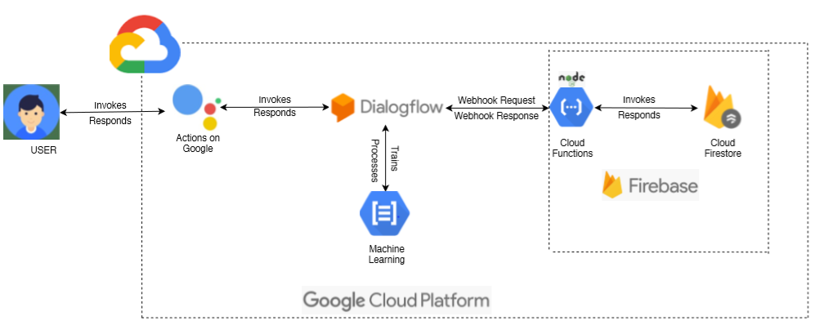
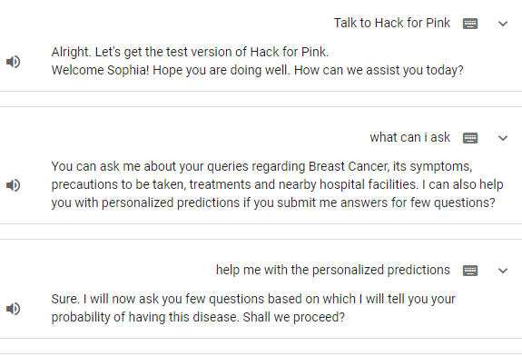
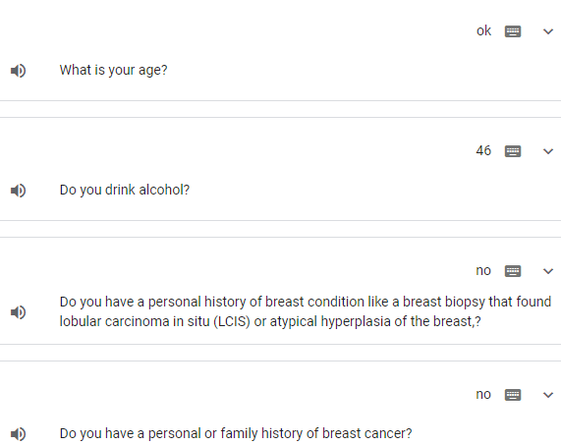
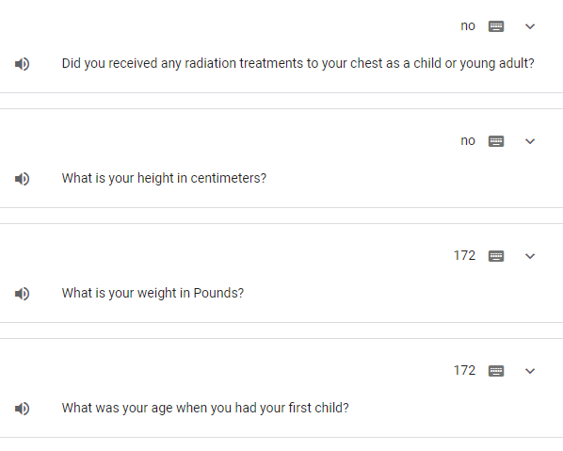
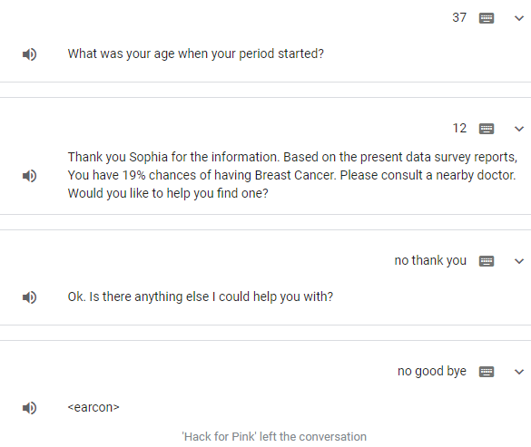
Technology Architecture

Slide 7

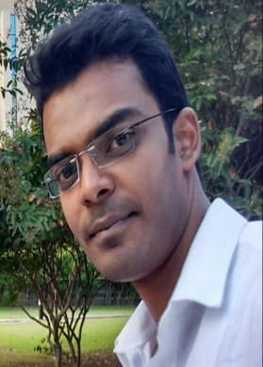
ELC HackForPink
Team: Infy Ninja
Team ID: 2AEFH5
Hackathon is about problem solving in time-boxing method, it is really what it is. And you can’t solve problem unless you have an ability or empathy to perceive all that’s around you. The more you understand and what the problem is through other people’s lens the more you can solve for people in real life.
ELC Hackathon embraces collaboration across borders and cultures to bring about new ideas and innovations. We recognized to act on the urgency of creating awareness through technology for Breast Cancer. Goal is to support the larger society ecosystem with the power of technology to get innovation out in the field.
Viral Thakkar
Saurabh K Sinha

